Slide 1

Exploring the Impact of User Engagement Duration on Customer Conversion in Online Audiobook Platform

Slide 2
Agenda
Problem Statement
Research Question
Data Overview
Methodology
Analysis and Findings
Hypothesis Testing
Recommendations

Slide 3
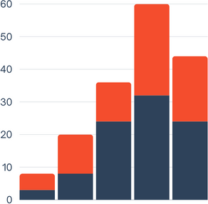
Problem Statement
The objective of this study is to investigate the relationship between the duration of user engagement, as indicated by the time elapsed between a user's first purchase and their last visit to the platform, and customer conversion in an online audiobook platform.
The analysis aims to determine whether users who engage with the platform over a longer period of time are more likely to convert into repeat customers by making additional purchases.

Slide 4
Research Question
Is there a relationship between user engagement duration and customer conversion?
Does the duration of user engagement, measured by the difference between the last visited date and the first purchase date, influence customer conversion?

Slide 5
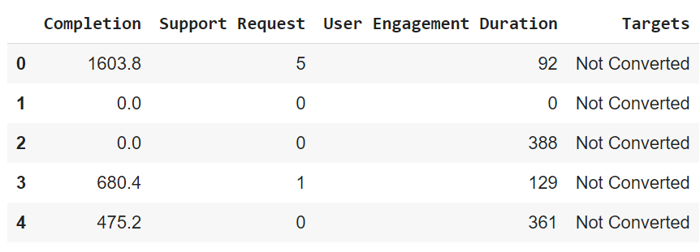
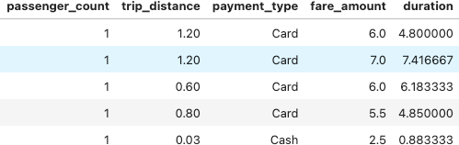
Data Overview
For this analysis, we utilized the comprehensive dataset of an audiobook application, used data cleaning and feature engineering procedures to concentrate solely on the relevant columns essential for our investigation.
Relevant columns used for this research:
Completion
Support Request(1 to 12)
User Engagement Duration (minutes)
Targets (0 or 1)

Slide 6
Methodology
Step | Description
Descriptive Analysis | Performed statistical analysis to summarize key aspects of the data, focusing on user engagement duration and customer conversion.
Hypothesis Testing | Conducted a T-test to evaluate the relationship between user engagement duration and customer conversion, testing the hypothesis that different user engagement duration influence target types (converted, not converted).

Slide 7
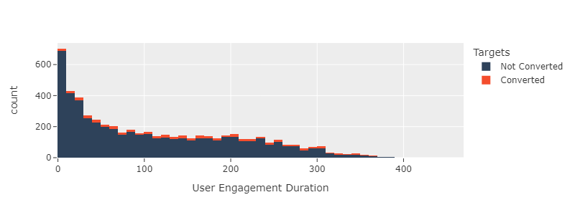
User Insights I
Majority of users show high engagement rate but have not purchased the subscription.
Some of the possible reasons could be:
Subscription price is too high for them
Satisfaction with free content
Limited payment options
Satisfied with ad-supported model
Trial period user
Checking multiple audio book platforms
May think it is not value for money

Slide 8
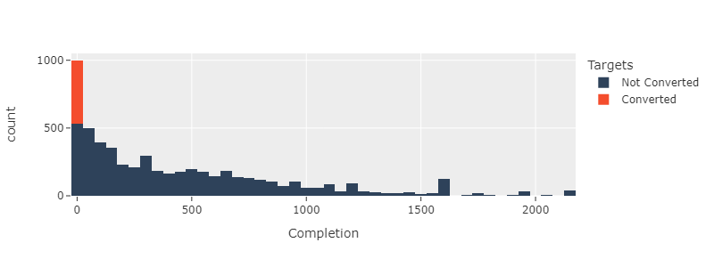
User Insights II
Those who purchased the subscription have 0 minutes of completion meaning they purchased soon as they joined.
Some of the possible reasons could be:
Could be under trial period
Impulse purchase / Limited-time offer / Promotional deal
Platform exploration and whether they should get the subscription renewed
Limited content of interest

Slide 9
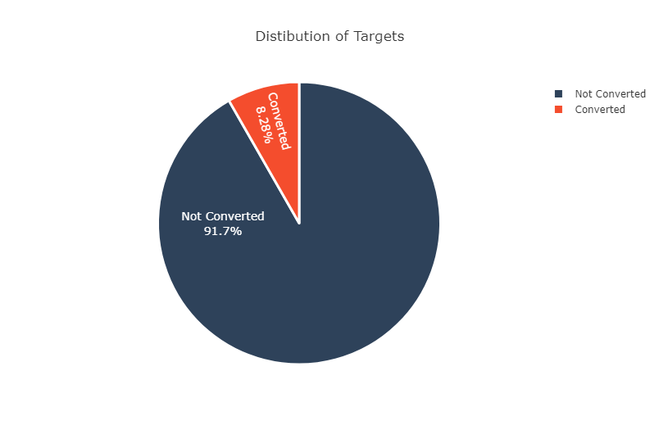
Distribution of Conversion Types
Users may have limited time available for consuming content, leading to lower completion rate but variations in engagement durations as they might be opening the app randomly when they are free.
Lack of personalization can diminish the overall engagement time

Slide 10
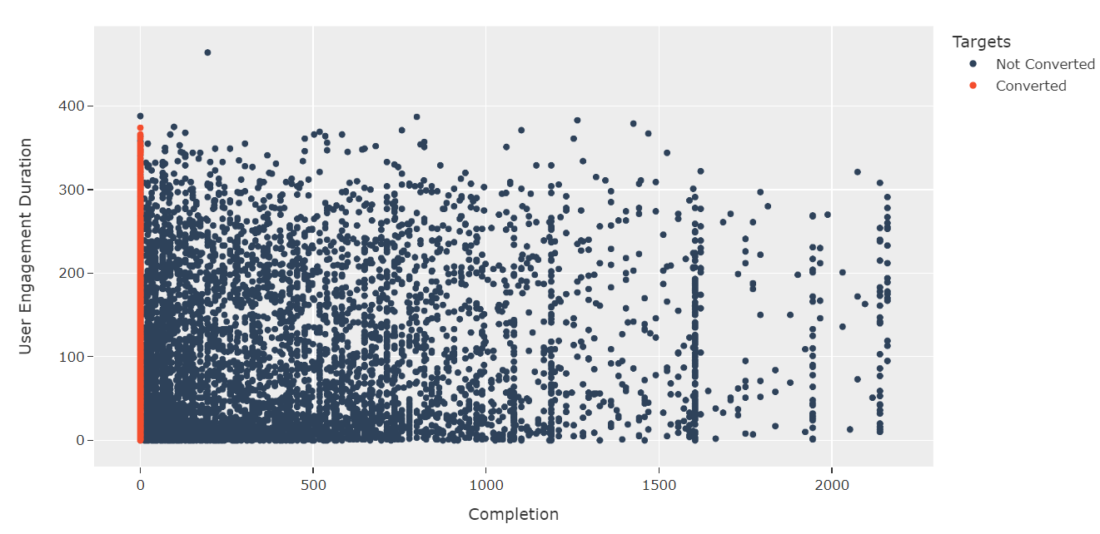
User Engagement Duration and Completion Analysis
This observation underscores a peculiar trend: despite registering a completion rate of 0, users are actively engaging with the platform, as evidenced by their user engagement duration falling within the range of 0 to 400
This suggests that while users may not be consuming content to completion, they are nonetheless frequently utilizing the platform's features.

Slide 11
Hypothesis Testing
Null Hypothesis (H0): There is no difference in the average user engagement duration between converted and unconverted users.
Alternative Hypothesis (H1): There is a difference in the average user engagement duration between converted and unconverted users.
Since the p-value is significantly smaller than the significance level of 5%, we will reject the null hypothesis. We conclude that there is a statistically significant difference in the average User Engagement Duration between customers who use purchased the subscription and users who did not.

Slide 12



Recommendations
Offer compelling incentives, such as exclusive content previews, limited-time discounts, or personalized subscription recommendations, to encourage engagement and prompt users to convert to paying subscribers.
Ensure clear communication of subscription benefits, pricing plans, and value propositions to facilitate informed decision-making and encourage immediate engagement post-subscription.
Leverage user data to tailor content offerings and engagement strategies to align with subscriber preferences and behaviors.

Slide 13
Thank you!

